Slide 1

Surveillance using NLP

Slide 2

About
The surveillance system is the mechanism for implementing security by watching over and eavesdropping masses. Modern designs comprise closed-circuit televisions (CCTV) feeding footage to security guards at the endpoint. This technique is very costly and erroneous. We have devised our project to mitigate the processes involved by eliminating the use of human labor. This way, we can avoid many human errors, such as false alerts, and most importantly, minimize costs. We can achieve this milestone by using Natural Language Processing (NLP). With the help of computers, this system can eavesdrop on masses on its own, without the need for any human being. We will use Bert Base for the sentiment analysis, especially the hate speech detection task with the audio feed. Thus, the system will be able to detect any anomalies threatening the safety and security of the public without involving any human being, avoiding privacy compromise.

Slide 3
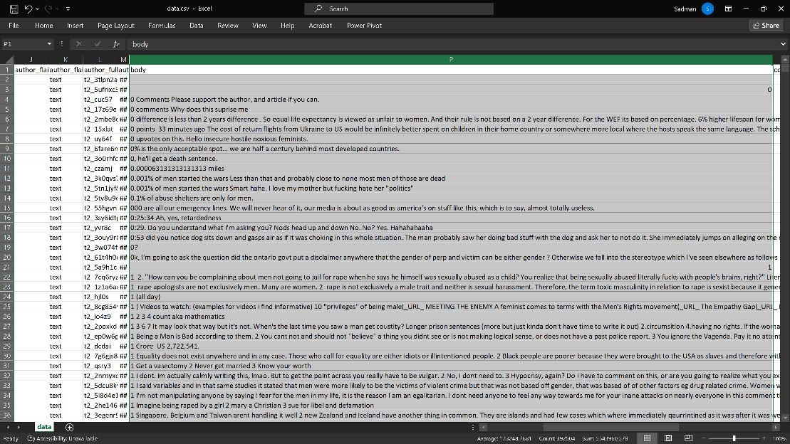
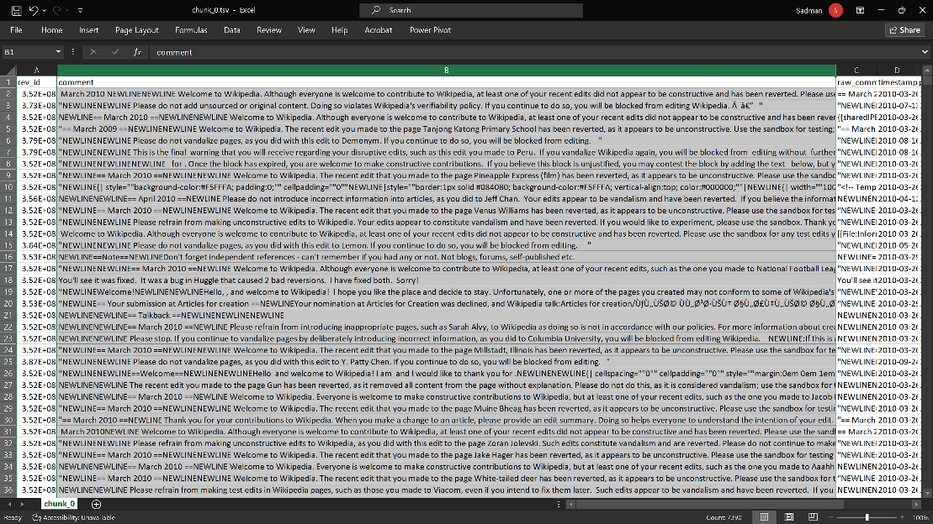
Dataset Statistics
Number of Classes: 2
Positive sample: Hateful and controversial Reddit comments [Kaggle Link]
MensRights_comment_1577836800_1609459200/data.csv [222 MB] Column: “body”
Negative sample: Wikipedia Talk Corpus [Kaggle Link]
comments_article_2010/comments_article_2010/chunk_0.tsv [193 MB] Column: “comment”

Slide 4
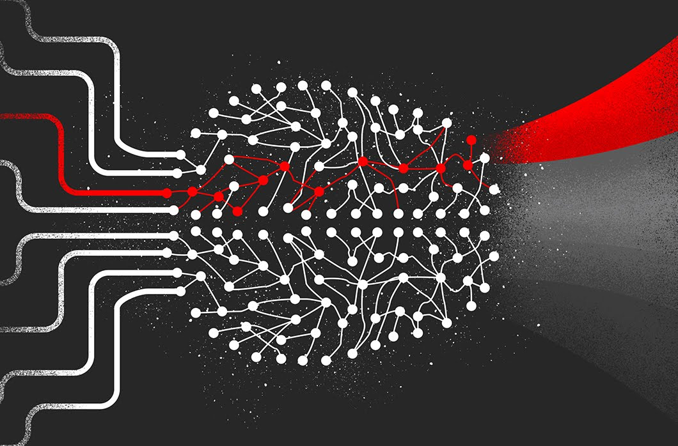

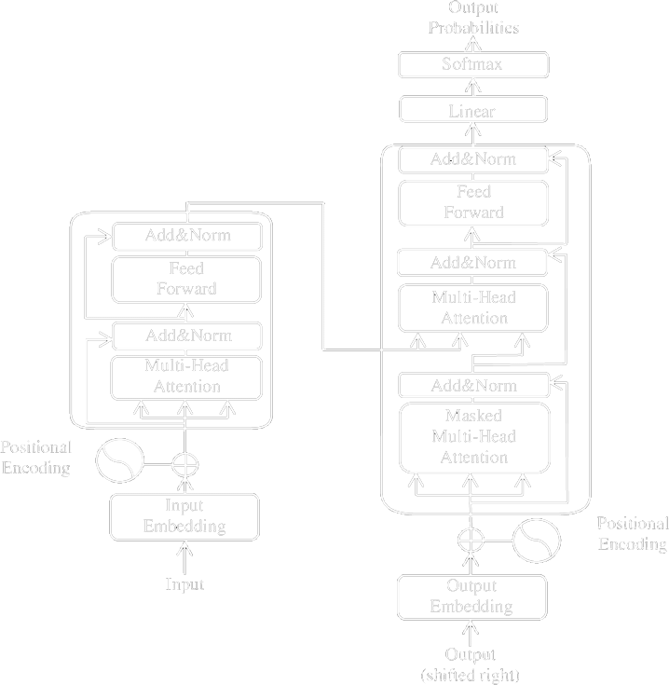
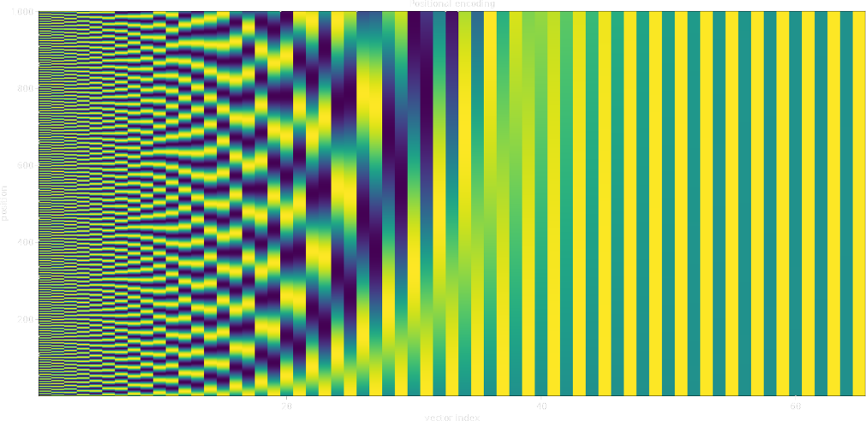
Initial Discussion
Motivation
The system will be able to eavesdrop and classify
Emotions
Algorithm
Transformer

Slide 5
Related Works
S. M. Qaisar, "Sentiment Analysis of IMDb Movie Reviews Using Long Short-Term Memory," 2020 2nd International Conference on Computer and Information Sciences (ICCIS), Sakaka, Saudi Arabia, 2020, pp. 1-4. [accuracy: 89.9%]
S. A. El Rahman, F. A. AlOtaibi and W. A. AlShehri, "Sentiment Analysis of Twitter Data," 2019 International Conference on Computer and Information Sciences (ICCIS), Sakaka, Saudi Arabia, 2019, pp. 1-4. [locked]
C. Kariya and P. Khodke, "Twitter Sentiment Analysis," 2020 International Conference for Emerging Technology (INCET), Belgaum, India, 2020, pp. 1-3. [locked]

Slide 6
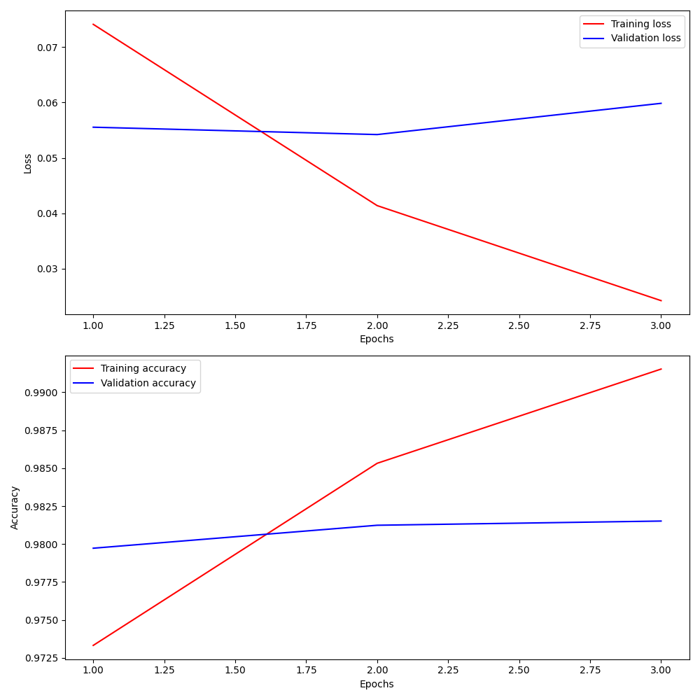
Training Curve

Slide 7
Stats
Total training time: 4 days, 17 hours, 41 minutes, 16.61 seconds
Average time per epoch: 1 days, 13 hours, 53 minutes, 45.54 seconds
Log:
2023-06-01 23:17:22,505 - INFO - __main__ - Using device: cuda
2023-06-01 23:19:39,116 - INFO - __main__ - Starting epoch 1
Finished epoch 1. Training loss: 0.07412954205598181, Training accuracy: 0.9733282637015082, Validation loss: 0.05554715911176079, Validation accuracy: 0.9797272774407632
Starting epoch 2
Finished epoch 2. Training loss: 0.04138461849877167, Training accuracy: 0.985320391369816, Validation loss: 0.05421789549932269, Validation accuracy: 0.9812395223034514
Starting epoch 3
Finished epoch 3. Training loss: 0.024222343772313238, Training accuracy: 0.9915249294104177, Validation loss: 0.059861925795933094, Validation accuracy: 0.981516047078343

Slide 8
Regularization & Optimization
In the script, the optimization is handled by the AdamW optimizer. AdamW is a variant of the Adam optimizer that includes weight decay. The learning rate is set to 1e-5. In this script, L2 regularization is applied through the weight decay in the AdamW optimizer.
Furthermore, the script uses gradient accumulation which involves accumulating gradients over multiple backward operations before performing a single update to the model parameters. In the script, the gradient accumulation steps are set to 4, meaning the optimizer step is only performed every 4 backward steps.
The script also uses mixed precision training which is a regularization technique to increase training speed and efficiency while maintaining model accuracy. This is implemented by the autocast and GradScaler operations. In the autocast context, operations run in an optimized datatype that CUDA suggests. GradScaler scales the loss and gradients to prevent underflow during backpropagation.
Finally, early stopping is implemented in the script as another regularization strategy. The model’s state is saved whenever a lower validation loss is found. This approach helps to avoid overfitting by stopping the model training when the model starts to perform worse on the validation set. The saved model can then be used as the final model, which is the model that performed best on the validation set.

Slide 9
Test Dataset
Number of Classes: 2
Positive sample:
Hateful and controversial Reddit comments [Kaggle Link]
TheRedPill_comment_1577836800_1609459200/data.csv [51.9 MB] Column: “body”
Negative sample:
Wikipedia Talk Corpus [Kaggle Link]
comments_article_2011/comments_article_2011/chunk_0.tsv [87.7 MB] Column: “comment”

Slide 10
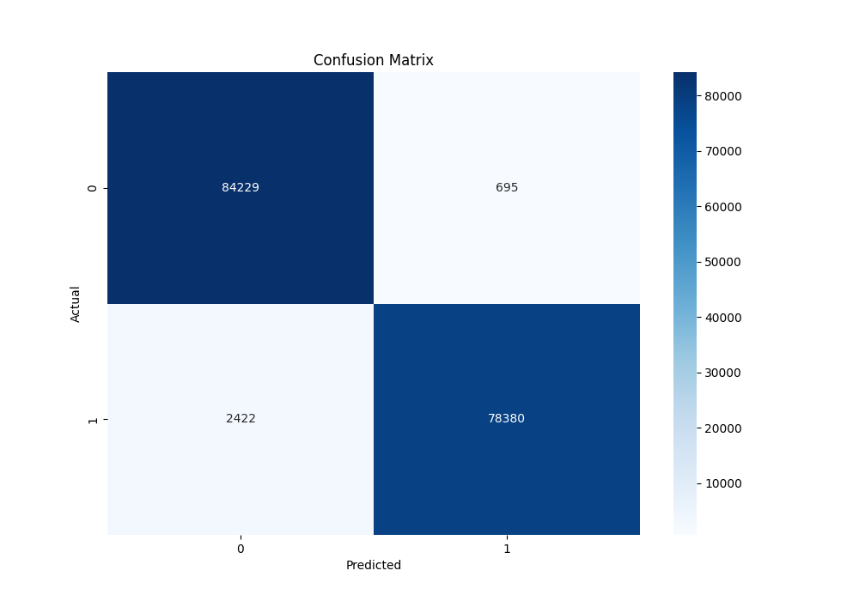
Test Metrics
Accuracy: 0.9811918467832447
Precision: 0.9912108757508694
Recall: 0.970025494418455

Slide 11
Conclusion
Train on all the hate datasets available online.
Combine with Deep Learning (DL) to extract visual features and speech recognition to utilize all the input data from CCTV.
By training on violence datasets, I can detect violence precisely.
Implement these models on hardware such as drone-attached cameras and Wi-Fi to practically surveil real life.
I will try to work on the research paper if all works well.

Slide 12

Thank You

